Slide 1

Patient Level Data De-Identification at LEO Pharma
Vesela Valentinova Kusheva
Clinical Disclosure Specialist
LEO Pharma A/S
Jørgen Mangor Iversen
Statistical Programmer
LEO Pharma A/S

Slide 2
Disclaimer
The views and opinions expressed in the following PowerPoint slides are those of the individual presenter and should not be attributed to DIA, its directors, officers, employees, volunteers, members, chapters, councils, communities or affiliates, or any organization with which the presenter is employed or affiliated.
These PowerPoint slides are the intellectual property of the individual presenter and are protected under the copyright laws of the United States of America and other countries. Used by permission. All rights reserved. DIA and the DIA logo are registered trademarks or trademarks of Drug Information Association Inc. All other trademarks are the property of their respective owners.

Slide 3
Disclosure Statement Vesela Valentinova Kusheva
❑ I have no real or apparent relevant financial relationships to disclose
❑ I am employed by a regulatory agency, and have nothing to disclose
Please note that DIA is not requesting a numerical amount to be entered for any disclosure, please indicate by marking the check box, and then providing the company name only for those disclosures you may have.
Will any of the relationships reported in the chart above impact your ability to present an unbiased presentation?  Yes  No
In accordance with the ACPE requirements, if the disclosure statement is not completed or returned, participation in this activity will be refused.
Type of Financial Interest within last 12 months |  | Name of Commercial Interest
 | Grants/Research Funding
 | Stock Shareholder | Novo Nordisk A/S, Genmab A/S Arena Pharmaceuticals, Inc.
 | Consulting Fees
 | Employee | LEO Pharma A/S
 | Other (Receipt of Intellectual Property Rights/Patent Holder, Speaker’s Bureau)
X
X
X

Slide 4
Disclosure Statement Jørgen Mangor Iversen
❑ I have no real or apparent relevant financial relationships to disclose
❑ I am employed by a regulatory agency, and have nothing to disclose
Please note that DIA is not requesting a numerical amount to be entered for any disclosure, please indicate by marking the check box, and then providing the company name only for those disclosures you may have.
Will any of the relationships reported in the chart above impact your ability to present an unbiased presentation?  Yes  No
In accordance with the ACPE requirements, if the disclosure statement is not completed or returned, participation in this activity will be refused.
Type of Financial Interest within last 12 months |  | Name of Commercial Interest
 | Grants/Research Funding
 | Stock Shareholder
 | Consulting Fees
 | Employee Wife’s employment | LEO Pharma A/S AJ Vaccines
 | Other (Receipt of Intellectual Property Rights/Patent Holder, Speaker’s Bureau)
X
X

Slide 5

PhUSE standard
Considered equivalent to EMA Policy 0070
Excel file, containing rules per data point in SDTM
Highly operational, utilizing irreversible algorithms
Available at the PhUSE web site
Requires registration, not membership

Slide 6
Rules Summary 1
Recoding of system identifiers
All system identifiers must be recoded, as they contain references to CRF subject numbers and site IDs. Applies to all data points used as identifiers.
Date offsetting
All dates for all subject are offset to the earliest date for the earliest subject. This way, all subject seems like they are entered in the study on the same day. Relative timelines are preserved.
Removal of data
Some datasets (the Comments domain) and some data rows and/or columns are removed.

Slide 7
Rules Summary 2
Elevate to continent
The ‘COUNTRY’ variable is elevated to continent, and the ‘COUNTRY’ variable is deleted.
Deriving and aggregating age
Ages > 89 are grouped into one. Small frequencies of age can be further grouped manually.
Handling of free text
Data points containing identifiable data in free text is removed as a general rule, but always inspected manually.
Data preserved unchanged
Most data points carrying results etc. needs no de-identification.

Slide 8
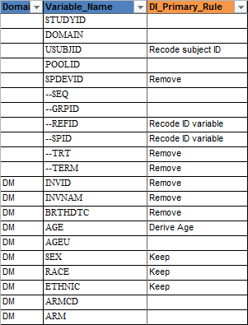
PhUSE Document Contents
Small excerpt of interesting columns

Slide 9
Mapping rules to macros
proc format;
value $rules
'Remove dataset' = '%di_remove_dsn'
'Derive Age' = '%di_derive_age'
'Offset' = '%di_offset'
'Elevate to continent' = '%di_continent'
'Recode subject ID' = '%di_recode_subject'
'Recode ID variable' = '%di_recode_id'
'Remove' = '%di_remove_var'
'Keep' = '%di_keep'
'No further de-identification' = '%di_no_further'
'Review and only redact values with personal information' = '%di_manual'
other = '';
run;

Slide 10
Examples
Data Point | Original | De-Identified
USUBJID | LEO123_4567_DK0089 | 17
SITEID | DK0089 | 35
Country | Denmark | Europe
Date | 12MAY1980 | 28MAR1980
Relative Date | 26 | 26

Slide 11
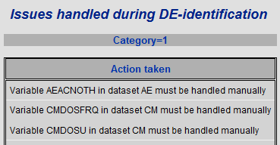
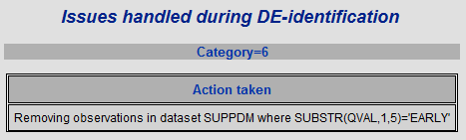
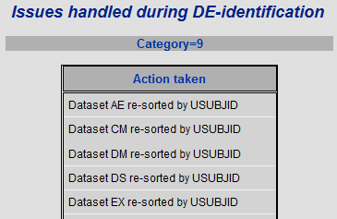
Reporting 1
Example of messages

Slide 12
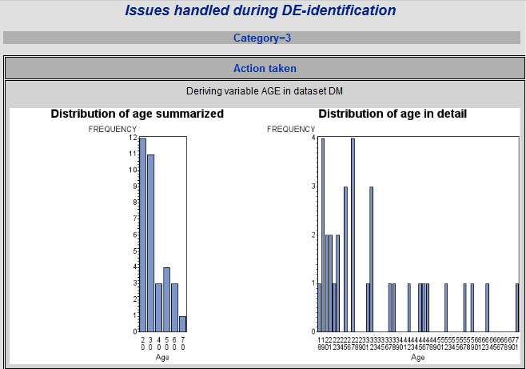
Reporting 2
Example of age distribution

Slide 13
Reference and contact
Download metadata from http://www.phuse.eu/Data_Transparency_download.aspx
after filling the form.
Contact details
Jørgen Mangor Iversen Vesela Valentinova Kusheva
jmidk@leo-pharma.com vakdk@leo-pharma.com

